Slide 1
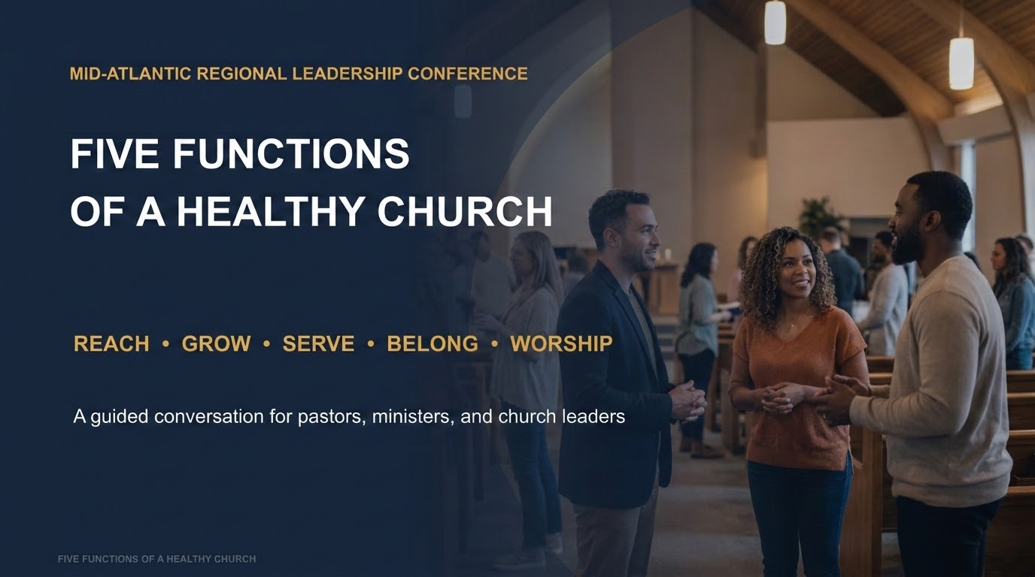


Slide 2

What does a healthy church look like?
Think about the church you lead—not only the church you hope to lead.
REACH
GROW
SERVE
BELONG
WORSHIP
People who need Jesus
People becoming like Jesus
People experiencing Christ’s compassion
People connected to the body
People centered on God
Which function is strongest in your church? Which needs the most attention?
FIVE FUNCTIONS OF A HEALTHY CHURCH
2

Slide 3
REACH
A Compelling Witness
“When you hear “evangelism,” what comes to mind?”
PRIMARY TEXT | Acts 2:41–47
Evangelism is a culture, not an event.
DISCUSS • LISTEN • CHALLENGE • APPLY
FIVE FUNCTIONS OF A HEALTHY CHURCH
4

Slide 4

REACH
Let’s talk
1
What did evangelism look like when you first came to Christ?
2
Has the way we reach people changed? What should never change?
3
Are we reaching people who aren’t like us—or mainly attracting people already comfortable with us?
FIVE FUNCTIONS OF A HEALTHY CHURCH
6

Slide 5
REACH
Go deeper
•
What might we do that unintentionally makes it harder for a newcomer to connect?
•
What is one barrier we could remove?
FIVE FUNCTIONS OF A HEALTHY CHURCH
7

Slide 6
REACH
THREE TAKEAWAYS
01
KNOW who you’re reaching
02
REMOVE unnecessary barriers
03
TELL your story and God’s story
WHAT IS ONE ACTION WE CAN TAKE?
FIVE FUNCTIONS OF A HEALTHY CHURCH
8

Slide 7
GROW
Comprehensive Discipleship
“How do we know when someone is actually growing spiritually?”
PRIMARY TEXT | Acts 2:42; 2 Timothy 2:2
Discipleship moves people from information to formation to transformation.
DISCUSS • LISTEN • CHALLENGE • APPLY
FIVE FUNCTIONS OF A HEALTHY CHURCH
9

Slide 8

GROW
Let’s talk
1
Is attendance a measure of discipleship—or only one part of the picture?
2
What helped you grow spiritually?
3
Can someone attend church for years and remain spiritually immature?
FIVE FUNCTIONS OF A HEALTHY CHURCH
11

Slide 9
GROW
Go deeper
•
Are we offering different pathways to the same biblical formation?
•
Where is one gap in our discipleship pathway?
FIVE FUNCTIONS OF A HEALTHY CHURCH
12

Slide 10
GROW
THREE TAKEAWAYS
01
TEACH the Word
02
PRACTICE the Word
03
BECOME like Christ
WHAT IS ONE ACTION WE CAN TAKE?
FIVE FUNCTIONS OF A HEALTHY CHURCH
13

Slide 11
SERVE
Compassionate Service
“What does our church do for people who may never become members?”
PRIMARY TEXT | Acts 2:45
Compassion meets real needs in the name of Christ.
DISCUSS • LISTEN • CHALLENGE • APPLY
FIVE FUNCTIONS OF A HEALTHY CHURCH
14

Slide 12

SERVE
Let’s talk
1
Is service a strategy to get people into church, or part of who we are?
2
What would our community say our church is known for?
3
What needs do we see in our community today?
FIVE FUNCTIONS OF A HEALTHY CHURCH
16

Slide 13
SERVE
Go deeper
•
What is one need—and one realistic way a church could respond?
FIVE FUNCTIONS OF A HEALTHY CHURCH
17

Slide 14
SERVE
THREE TAKEAWAYS
01
SEE the need
02
MEET the need
03
SHOW Christ
WHAT IS ONE ACTION WE CAN TAKE?
FIVE FUNCTIONS OF A HEALTHY CHURCH
18

Slide 15
BELONG
A Caring & Welcoming Community
“Can someone attend for six months and still feel like a stranger?”
PRIMARY TEXT | Acts 2:42, 44, 46; Hebrews 10:25
Welcome is a moment; belonging is built through relationships.
DISCUSS • LISTEN • CHALLENGE • APPLY
FIVE FUNCTIONS OF A HEALTHY CHURCH
19

Slide 16

BELONG
Let’s talk
1
If so, whose responsibility is it?
What made you feel that you belonged when you were new?
2
3
What helps different generations feel seen—and what makes them feel overlooked?
FIVE FUNCTIONS OF A HEALTHY CHURCH
21

Slide 17
BELONG
Go deeper
•
How do we honor what previous generations built while making room for those coming behind us?
•
What moves someone from welcome to meaningful connection and service?
FIVE FUNCTIONS OF A HEALTHY CHURCH
22

Slide 18
BELONG
THREE TAKEAWAYS
01
WELCOME people
02
CONNECT people
03
EMPOWER people
WHAT IS ONE ACTION WE CAN TAKE?
FIVE FUNCTIONS OF A HEALTHY CHURCH
23

Slide 19
WORSHIP
Dynamic Worship & Prayer
“What makes worship meaningful or powerful to you?”
PRIMARY TEXT | Acts 2:42, 47
Worship is more than what happens on Sunday; it centers the church on God.
DISCUSS • LISTEN • CHALLENGE • APPLY
FIVE FUNCTIONS OF A HEALTHY CHURCH
24

Slide 20

WORSHIP
Let’s talk
1
Can a service be excellent and still miss the heart of worship?
2
What has changed about worship—and what should never change?
3
How can worship speak to culture without being controlled by it?
FIVE FUNCTIONS OF A HEALTHY CHURCH
26

Slide 21
WORSHIP
Go deeper
•
Is prayer foundational, or does it get whatever time is left?
•
What is one practical way to strengthen prayer and response?
FIVE FUNCTIONS OF A HEALTHY CHURCH
27

Slide 22
WORSHIP
THREE TAKEAWAYS
01
PREPARE the service
02
PURSUE God’s presence
03
MAKE space for response
WHAT IS ONE ACTION WE CAN TAKE?
FIVE FUNCTIONS OF A HEALTHY CHURCH
28

Slide 23

REFLECTION
Where will we lead differently?
Our church’s greatest strength:
Our church’s greatest gap:
The function I need to strengthen:
One action I will take in the next 30 days:
FIVE FUNCTIONS OF A HEALTHY CHURCH
29

Slide 24
A HEALTHY CHURCH
Healthy churches don’t happen by accident.
They are cultivated by leaders who lead with intention.
REACH. \GROW. SERVE. BELONG. WORSHIP.
FIVE FUNCTIONS OF A HEALTHY CHURCH
30

