Slide 1

LEADERSHIP CONFERENCE 2026

Slide 2

Leadership Conference 2026
THE GRIND OF ENEMY ATTACK

Slide 3

THE GRIND OF ENEMY ATTACK
I am describing the relentless exhausting, and often repetitive pressure of spiritual opposition that attempts to wear down the believer’s faith, weaken their resolve, disturb their peace, and hinder their purpose in God. The word “Grind,” suggests something that happens gradually and persistently. Rather than one major attack, it is the accumulation of ongoing pressures, disappointments, temptations, conflicts, and discouragements that can leave a person physically, spiritually, emotionally and mentally exhausted.

Slide 4

Psalm 91 has a unique tone in its message as well. We discover this by reading through and looking at/for words or phrases that communicate similar thoughts.
Verse 5: Terror by night….
arrow…. by day
Verse 6: Pestilence….
Destruction
Verse 7: A thousand may fall
Verse 1: Shelter
Verse 9: Refuge
Verse 2: Refuge…. Fortress
Verse 11: Guard
Verse 4: Refuge…. Shield
Verse 15: Rescue

Slide 5
This is a song for battle in that it conveys an atmosphere of daily, oppressive enemy attacks. Who is the enemy? Is it Israel’s national foes? No. Is it a human being that is opposing the author?
I don’t think so.
Is it an actual, visible war on a bloody battlefield?
No, I doubt it.
Look at several verses as we identify the enemy:
Verse 3: The Trapper
Verse 8: The Wicked
Verse 10: Evil

Slide 6

“It is that conflict that is being waged in the invisible spiritual realm that is being manifest in the visible, physical realm.”
It is a battle between invisible angelic forces that affect you and me ( Eph 6:12).
Some Christians don’t even know they are at war. But others can see the results of the battle in their lives.
WHAT IS SPIRITUAL WARFARE:

Slide 7
THERE ARE FOUR AREAS OF LIFE
THAT WE FEEL THE IMPACT OF THE BATTLE:
Here is a Principle to Remember:
“Everything we see in the visible, physical realm is cause, provoked, or at least influenced by something in the invisible, spiritual realm.”
Personal Impact
Family Impact
Church Impact
Cultural Impact

Slide 8
Psalm 91 Outline
1. Protection amidst and during Evil (vv. 1-4)
2. Attitude toward Evil (vv. 5-10)
3. Assistance against Evil (vv. 11-13)
4. Security from Evil (vv. 14-16)

Slide 9
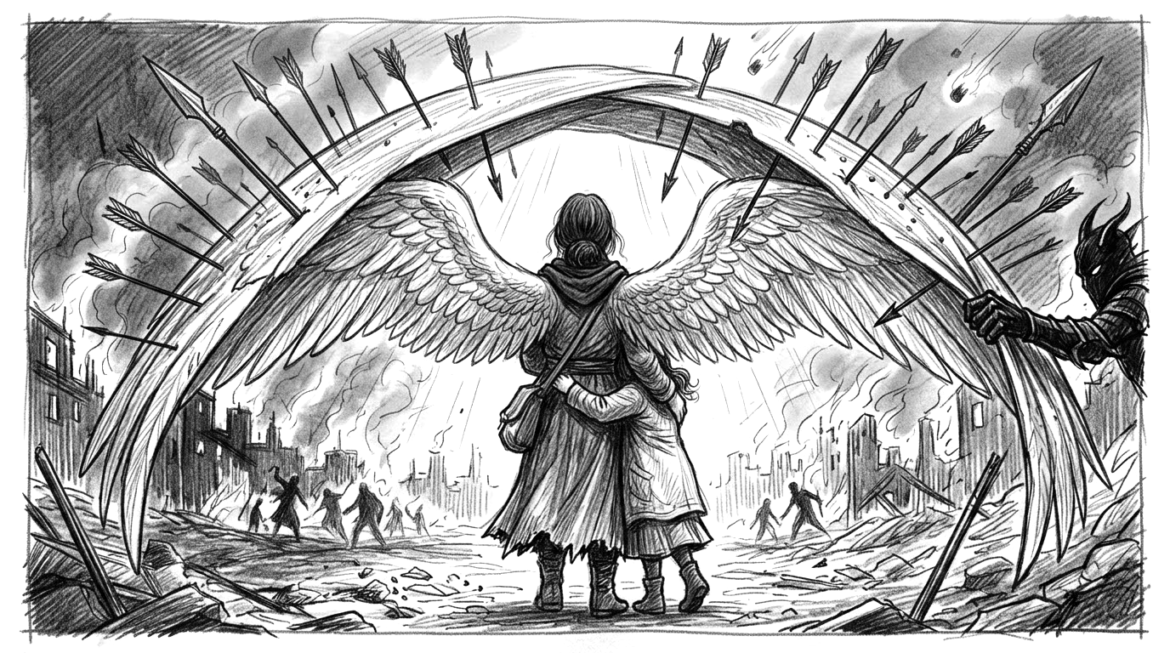
PROTECTION AMIDST AND DURING EVIL

Slide 10
Protection Amidst and During Evil
A “Refuge” is a place of rest.
A “Fortress” is a place of defence.

Slide 11
Verses 1 and 2 deals with who God is,
but verses 3 and 4 deals what God does.
Basically there are three things named:
A. He delivers: from the snare of the trapper and from the deadly pestilence.
B. He covers: with His pinions/ under His wings.
C. He shields: By His faithfulness.

Slide 12
Let’s look at the specific things that
God provides for us in times of enemy attack.
i. He Delivers from the snare of the Trapper.
ii. He Covers with His pinions/under His wings.
iii. He Shields us by His Faithfulness.

Slide 13
2. Attitude Toward Evil
There are two invincible attitudes
we are to exhibit toward evil:
i. No Fear (vv. 5-6) “You will not be afraid of the terror by night, or of the arrow that flies by day; of the pestilence that stalks in darkness, or of the destruction that lays waste at noon.”

Slide 14
2. Attitude Toward Evil
There are two invincible attitudes we are to exhibit toward evil:
i. No Fear (vv. 5-6) “You will not be afraid of the terror by night, or of the arrow that flies by day; of the pestilence that stalks in darkness, or of the destruction that lays waste at noon.”
ii. Faith ( vv. 7-10) “A thousand may fall at your side and ten thousand at your right hand, but it shall not approach you. You only look on with your eyes and see the recompense/ punishment of the wicked. For you have made the Lord, my refuge, even the most High, your dwelling place. No evil will befall you, nor will any plague come near your tent.”

Slide 15
I find that there are at least four Biblical truths for the Christian when undergoing or seeking release from satanic/demonic attacks:
1. The Cross
2. The Blood
3. The Name
4. The Word

Slide 16
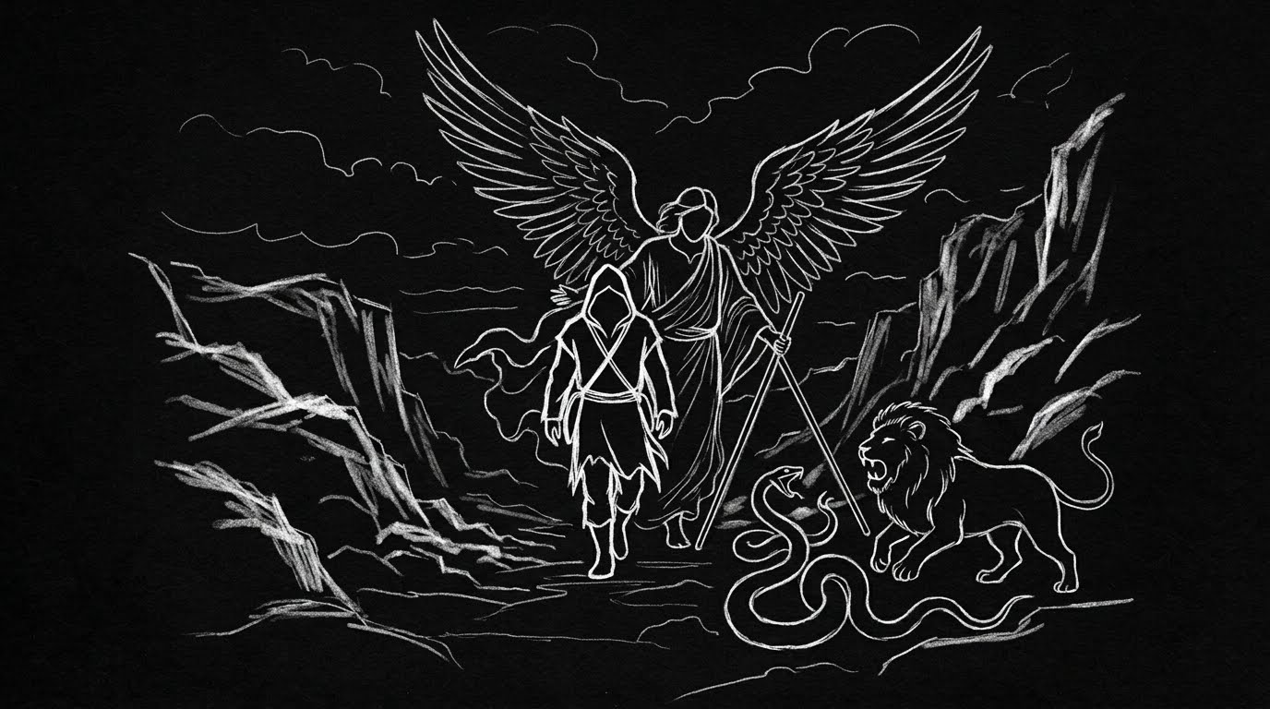
3. ASSISTANCE AGAINST EVIL ( vv. 11-13)

Slide 17
3. Assistance Against Evil ( vv. 11-13)
In vv. 11-13 there are
three distinct activities of the angels on our behalf.
i. Angels are given “charge” of us (v.11)
ii. Angels “guard” us in all our ways (v.11)
iii. Angels “bear you up” In their hands (v.12)

Slide 18
4. Security From Evil
He declares six “I wills”:
-I will deliver him (v.14)
-I will set him securely on high (v.14)
-I will answer him (v.15)
-I will be with him in trouble ( v. 15)
-I too rescue him in and honor him (v.15)
-I will satisfy him (v. 16)

Slide 19
God gives these promises to “dwellers” “clingers,” believers who by faith, wrap themselves around their Saviour, “He who stays in the shelter of the Most High will abide in the shadow of the Almighty.”
What a way to live. As a matter of a fact, it is the only way to live.

Slide 20
LEADERSHIP CONFERENCE 2026
LEADERSHIP CONFERENCE 2026

